Slide 1
Intermediate RNA-seq data analysis
Gladstone Institutes
Michela Traglia and Min-Gyoung Shin
Bioinformatics Core, GIDB
March, 21st 2022

Slide 2
Materials for this workshop
Concepts: this presentation
Hands-on session:
- Dec2021handson.R
- targets.txt
- GSE60450_Lactation-GenewiseCounts.txt.gz
Please install the following library in Rstudio
Install.packages(magrittr)
Install.packages(edgeR)
Install.packages(org.Mm.eg.db)
Install.packages(tidyverse)
Install.packages(ggplot2)
Install.packages(statmod)

Slide 3
Assumed background
Familiarity with R and RStudio
Familiarity with RNA-seq protocol
Familiarity with basic concepts of statistics and hypothesis testing

Slide 4
Introductions
Min-Gyoung Shin
Bioinformatician II
Michela Traglia
Statistician III

Slide 5



RNA-seq - analysis workflow
Biological samples
Session 1: Concepts + Demo
Library preparation
Sequencer: Reads Fastq
Quality check
FastQC
Trimming
cutadapt
Quality check
FastQC
Alignment/Mapping
STAR
Quality check
Session 2: Concepts + Demo
Counting Reads
featureCounts
Quality check
Notes:
See Intro to RNA-seq workshop materials at https://github.com/gladstone-institutes/Bioinformatics-Workshops/blob/master/intro-rna-seq/

Slide 6
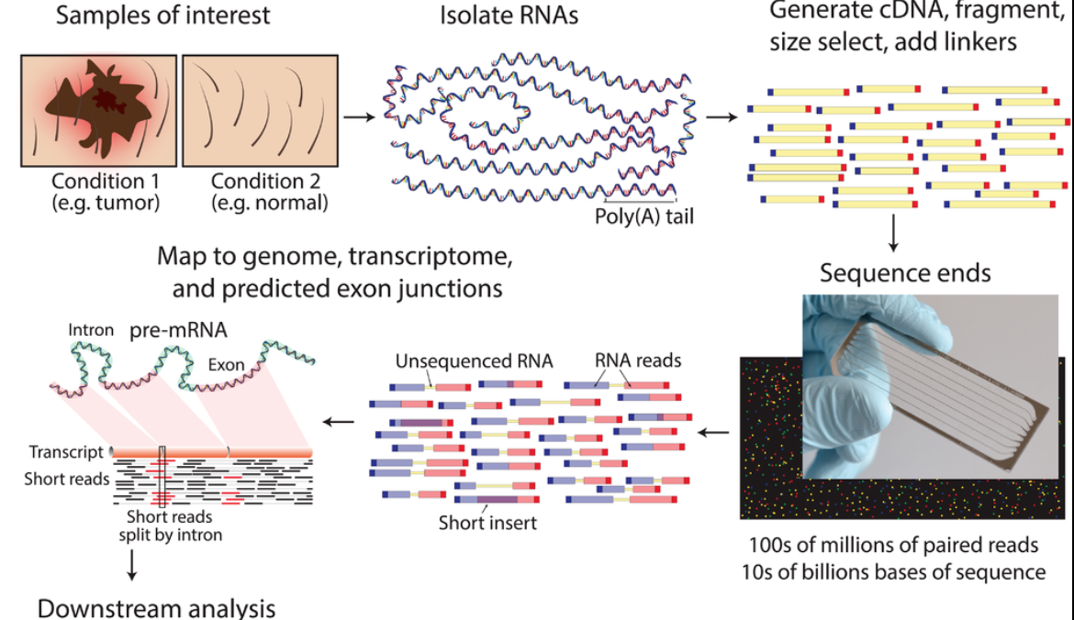
Typical RNA-seq protocol
https://www.wikiwand.com/en/RNA-Seq

Slide 7
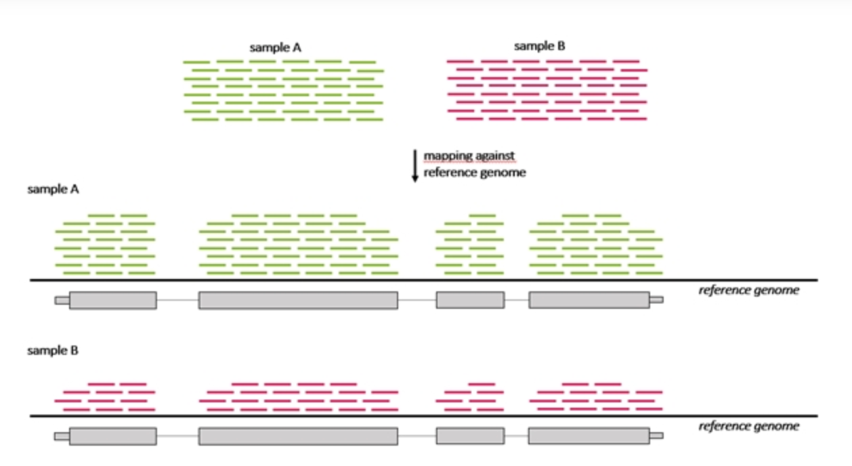
Many steps to calculate the Differentially Expressed Genes (DEG) between sample A and B

Slide 8
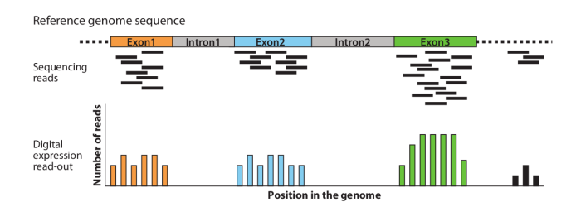
Goal of DEG analysis
Identify genes or molecular pathways that are differentially expressed (DE) between two or more biological conditions

Slide 9
Workshop outline
Intro to a real experiment – Demo
Steps for Differentially Expressed Gene analysis
Approach for DEG: edgeR
Filtering genes
Dealing with noisy data -> Normalization
Quality check - Exploratory visualization: MDS - PCA
Fit the model for DEG - dispersion
Which comparison and how to visualize the DEG

Slide 10
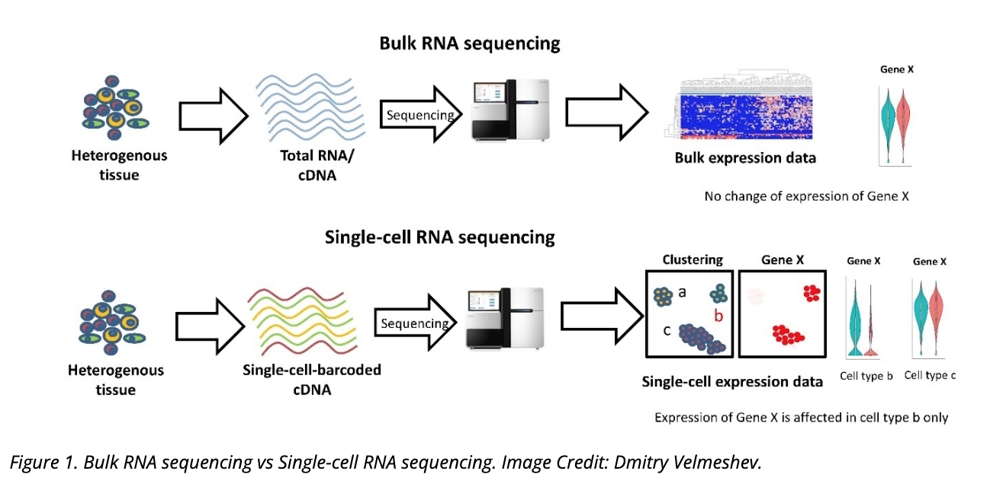
Bulk RNA-seq vs single cell (sc) RNA-seq

Slide 11
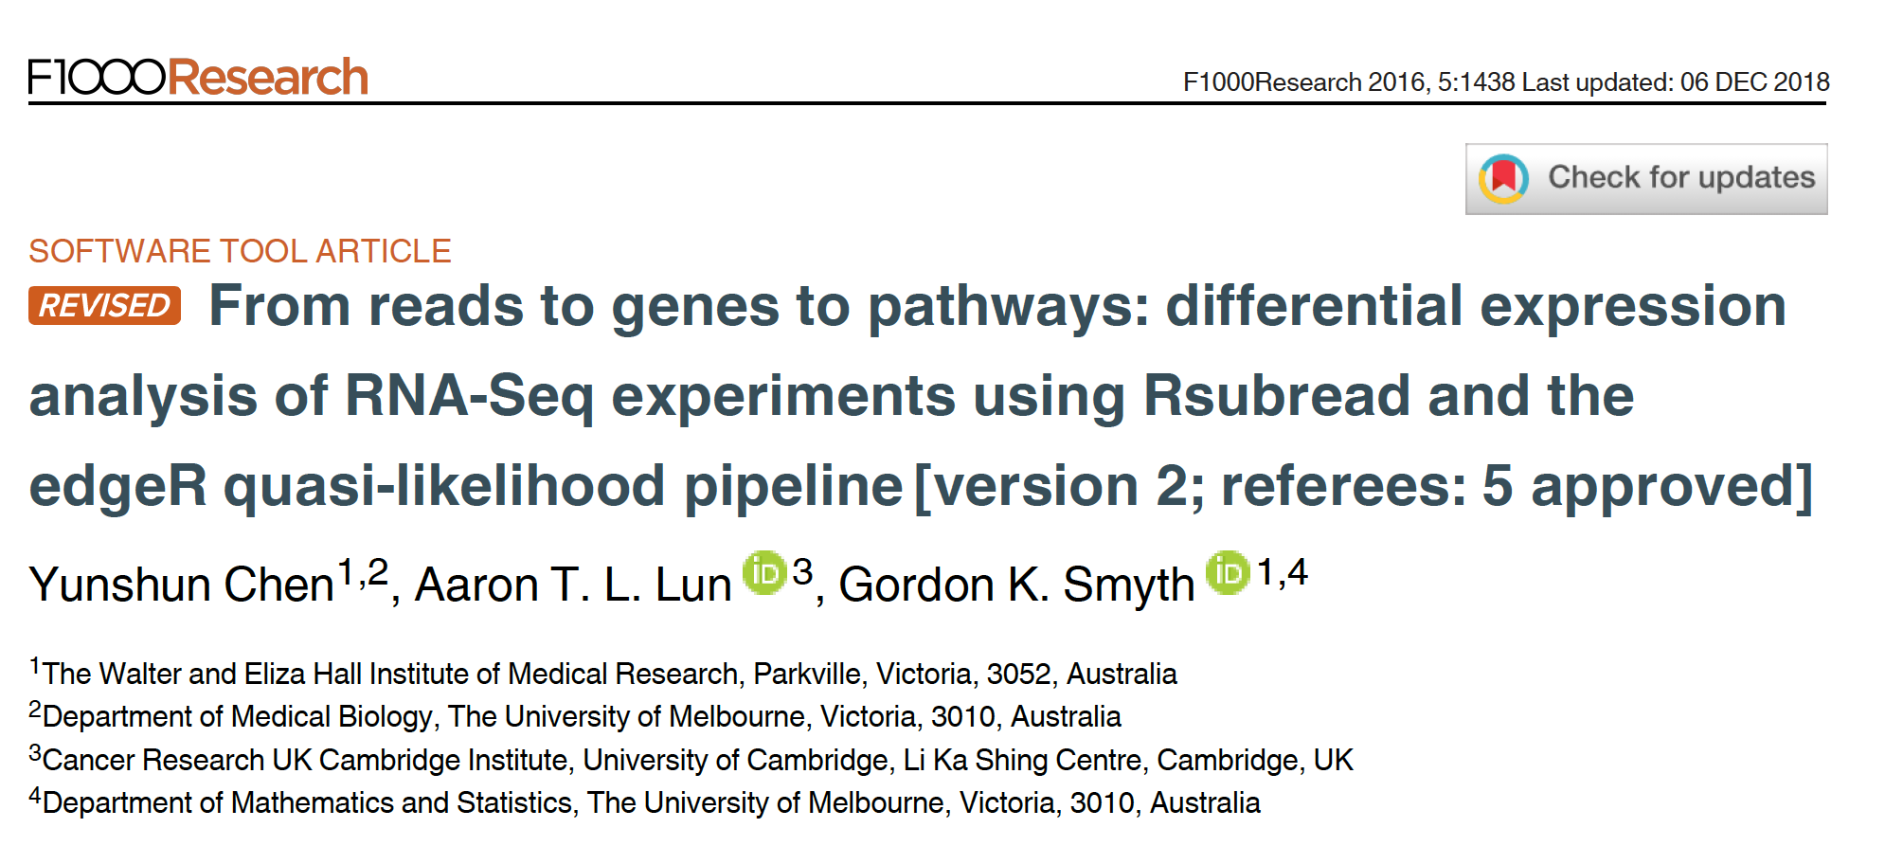
Reference for the workshop
Notes:
Relevant reading for theory:
1. Chen, Yunshun, Aaron TL Lun, and Gordon K. Smyth. "Differential expression analysis of complex RNA-seq experiments using edgeR." Statistical analysis of next generation sequencing data. Springer, Cham, 2014. 51-74.

Slide 12
Dataset
Transcriptome analysis of luminal and basal cell subpopulations in the lactating versus pregnant mammary gland
GEO accession: GSE60450
Tissue of origin: Mammary glands of mouse
Cell types: Basal stem-cell enriched cells (B) and committed luminal cells (L)
Biological conditions: Virgin, Lactating (2 day) and Pregnant (18.5 day)
# of groups: 2 cell types x 3 conditions = 6 groups
# of replicates: 2 of each group
Illumina Hiseq sequencer - about 30 million 100bp single-end reads for each sample.
https://www.ncbi.nlm.nih.gov/geo/

Slide 13
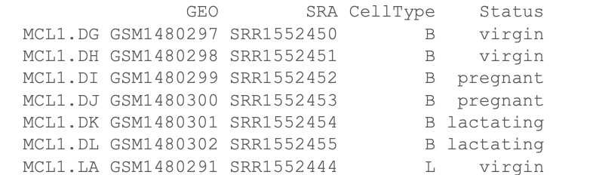
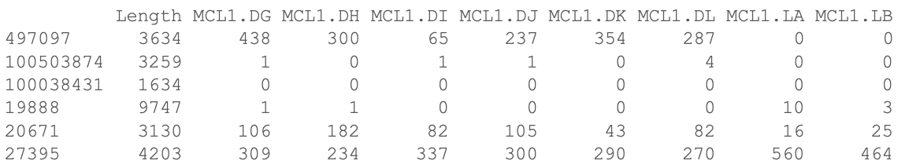
Files for the hands-on session
targets.txt
Phenofile
GSE60450_Lactation-GenewiseCounts.txt.gz
Counts for each sample for each gene(Entrez Gene Identifiers)

Slide 14
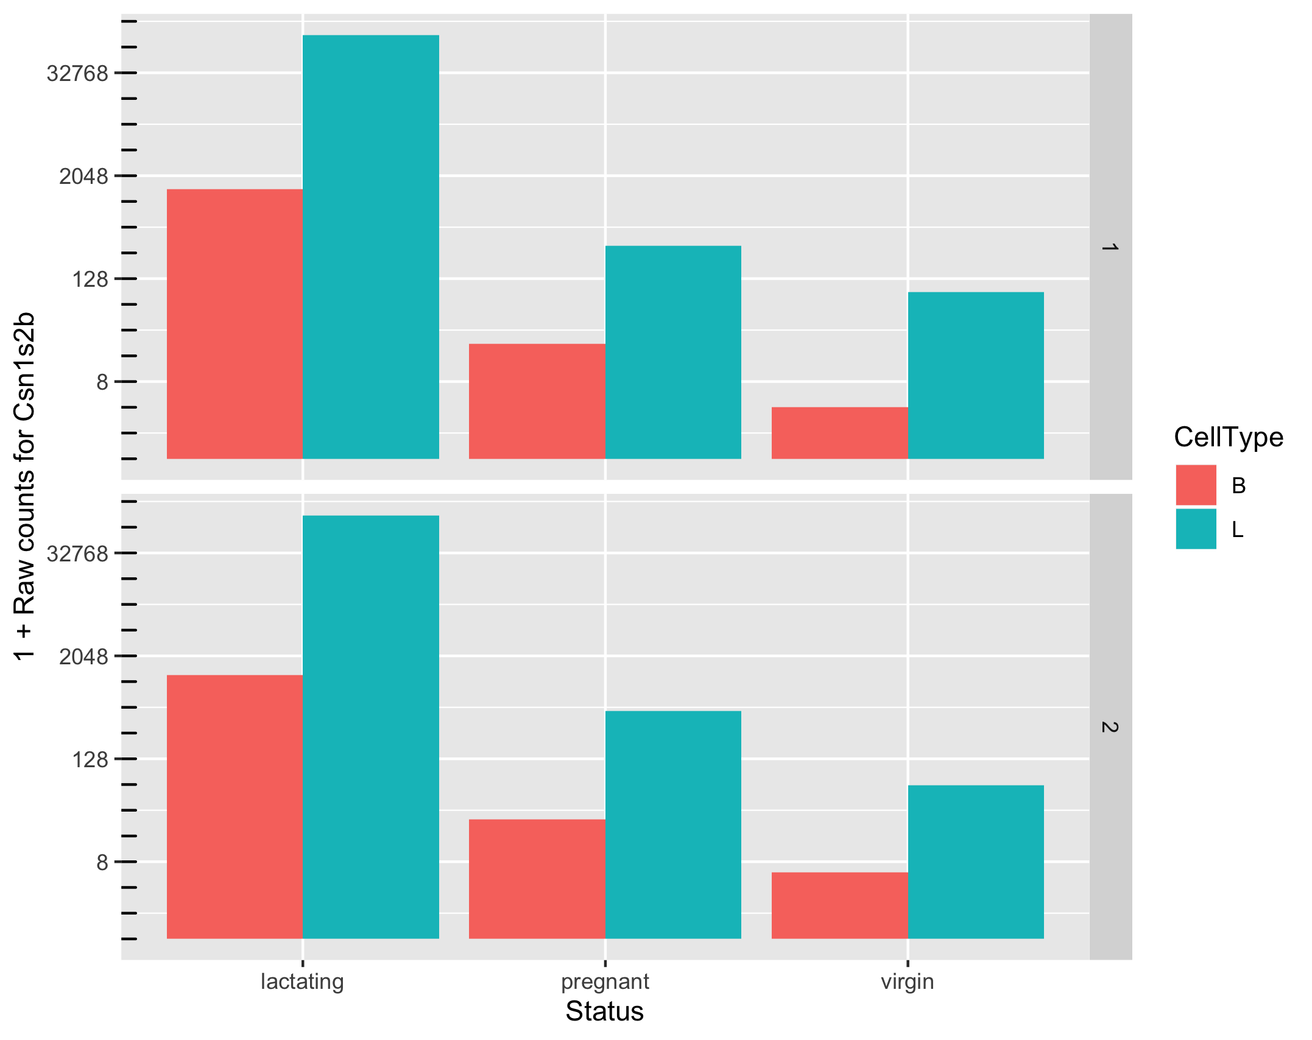
Goal: To identify a set of genes that are differentially expressed
Which comparisons are we interested in?
Example:
B vs L,
B.lactating vs L.pregnant,
...
All of them

Slide 15
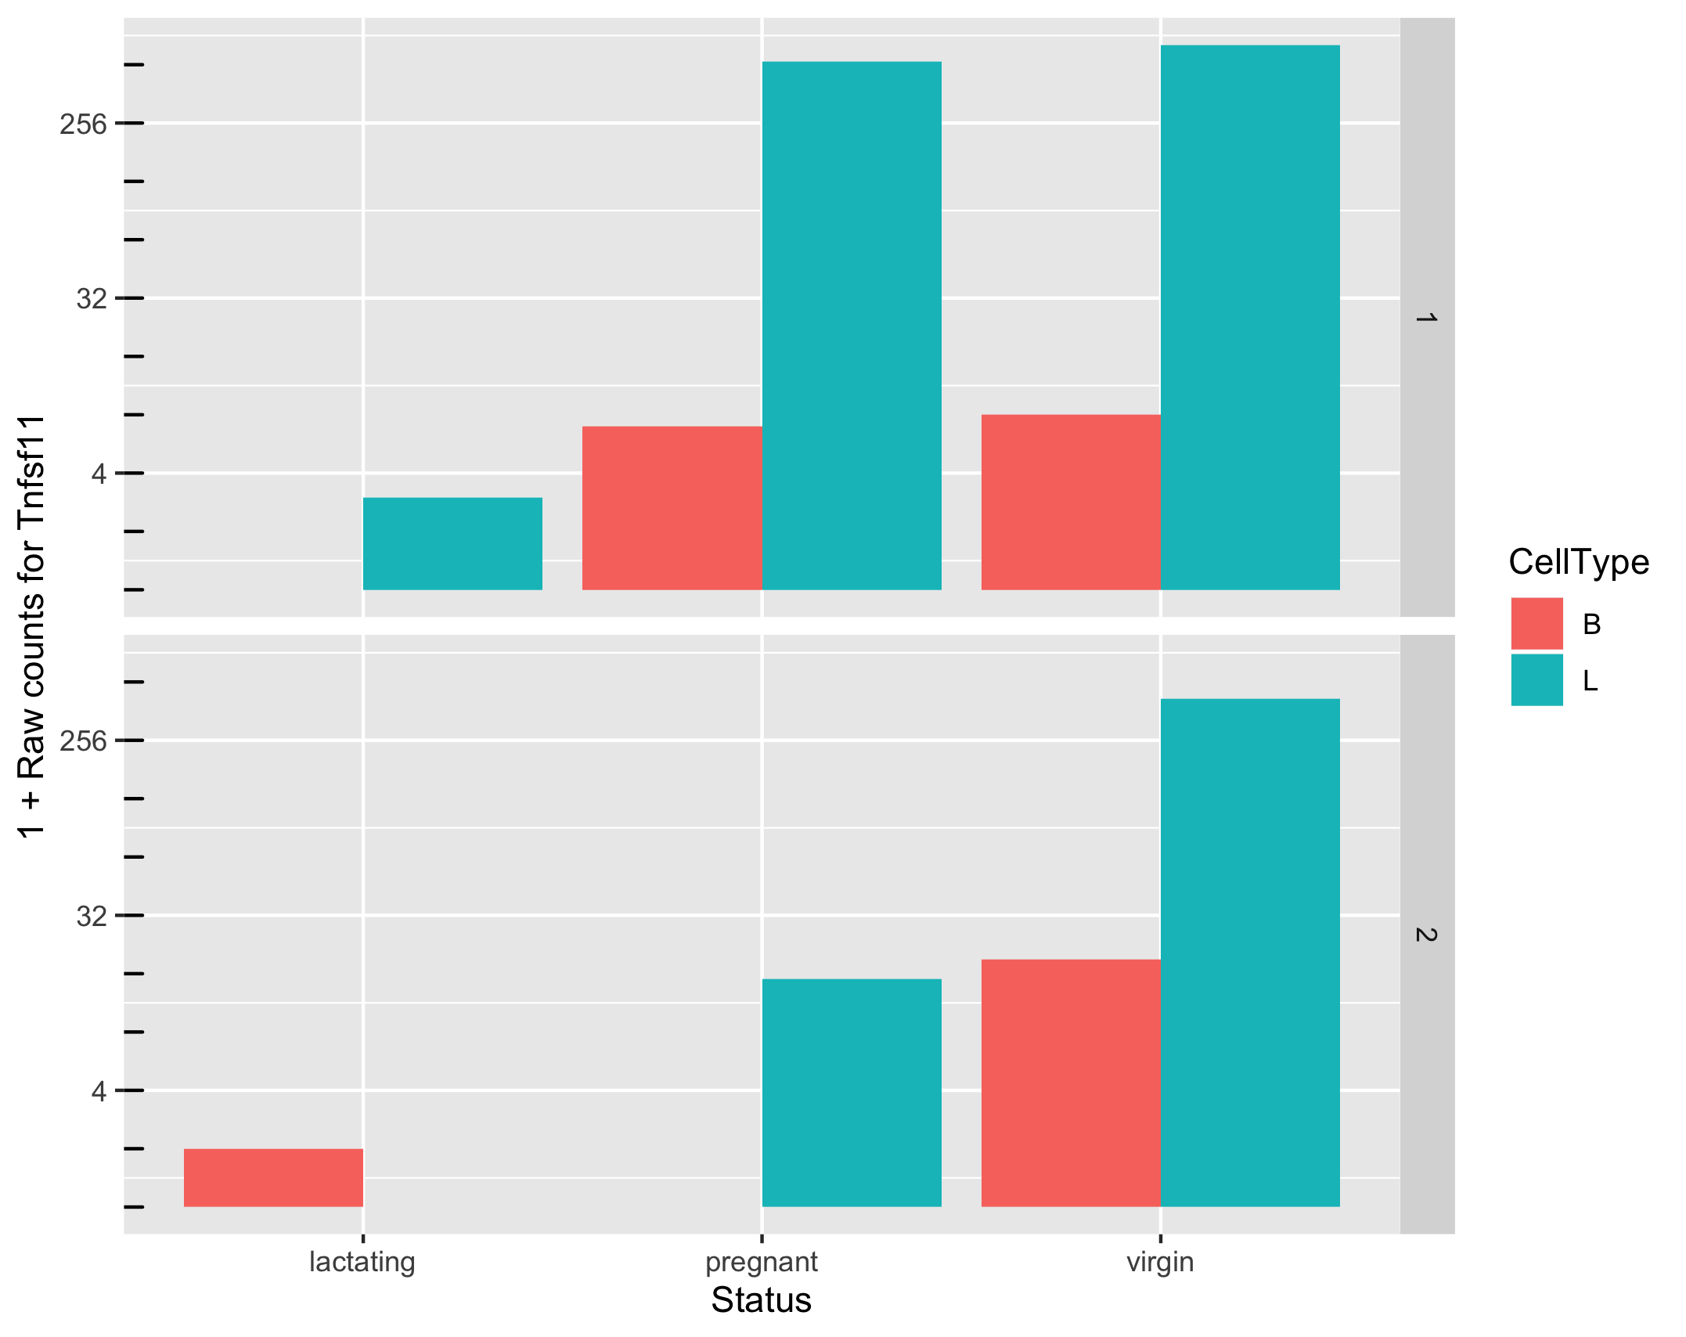
Goal: To identify a set of genes that are differentially expressed
How do we ensure high power for detection and high specificity when faced with noise?
Can we make reliable inferences for genes with very low counts? What should we consider “very low”?

Slide 16
Approach to identify DE genes: edgeR
edgeR utilizes a theoretical model that captures some of the known processes leading to noise in counts data. (null model)
Assume that the data is generated according to this model.
Given any observed level of difference in mean expression levels of a gene, compute the probability that the observation will result from the null model. (p value)
If the probability is very low (e.g., p < 0.05), infer that something may be happening that we did not account for in the null model. (e.g., biological processes in L cells for milk production)
Notes:
p-value is the probability of an observed (or more extreme) result assuming that the null hypothesis is true

Slide 17
Need to correct for multiple testing
P value represents the chance that we may be wrong in calling something significantly differential. Example:
P = 0.01 means 1% chance that we may be wrong.
P = 0.50 means 50% chance that we may be wrong.
More than 20k genes under consideration
=> if a certain difference in expression levels has only 1% chance of happening given the null model, it
might be observed for 200 genes even if the null model were true for all the genes.
=> 200+ false positives
Hence, there is a need to adjust the p-values.
- The more genes we test, the more we must adjust.
- Reduce the number of tests by filtering out “uninteresting” genes.

Slide 18
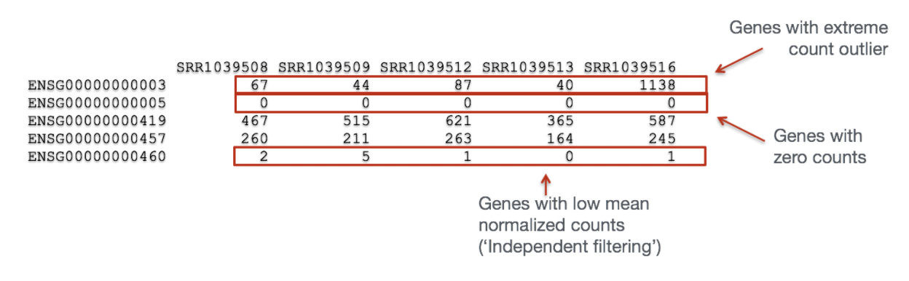
“Uninteresting” genes Filtering
Biological point of view: minimal expression level of a gene -> translation into a protein -> biologically relevant
Statistical point of view: low counts -> not enough statistical evidence.
Genes with consistently low counts are very unlikely be assessed as significantly DE

Slide 19
Normalization of the counts

Slide 20
Why we need to normalize the counts
Identify and correct technical biases removing the least possible biological signal
- library prep, sequencing technology, …
It is an essential step in the analysis of gene expression:
- to compare gene expressions from a same sample
- to compare genes from different samples (differential analysis)
Goals of normalization:
1) accurate estimation of gene expression levels
2) reliable differential expression analysis

Slide 21
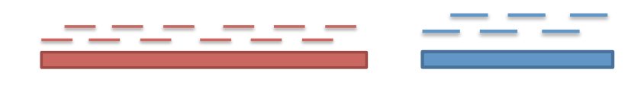
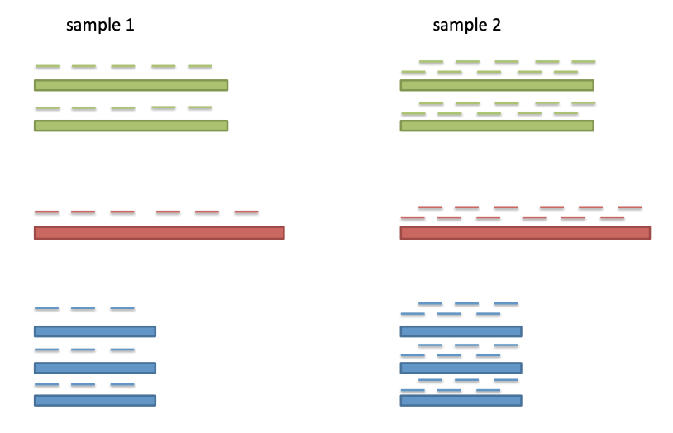
Gene-length and sequence depth
At the same expression level, a long gene will have more reads than a shorter one
Higher sequencing depth, higher counts

Slide 22
Gene expression units
Various gene expression units such as RPM, RPKM, FPKM, TPM, TMM, DESeq, Scnorm, raw counts
Measure of the abundance of gene or transcripts.
Normalized expression units are necessary to remove technical biases in sequenced data such as depth of sequencing and gene length, and make gene expressions directly comparable within and across samples.
To remove batch effects

Slide 23
Which other factors might cause variation in counts?
Sequence depth
Variation in sequencing depths => Need to normalize counts
Group | Total counts
B.virgin | 23085177
B.virgin | 21628857
B.pregnant | 23919152
B.pregnant | 22490570
B.lactating | 21382233
B.lactating | 19884434
Group | Total counts
L.virgin | 20213223
L.virgin | 21509988
L.pregnant | 22073815
L.pregnant | 21837341
L.lactating | 24638939
L.lactating | 24581591
Library size about 20M

Slide 24
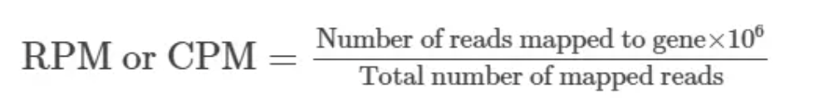
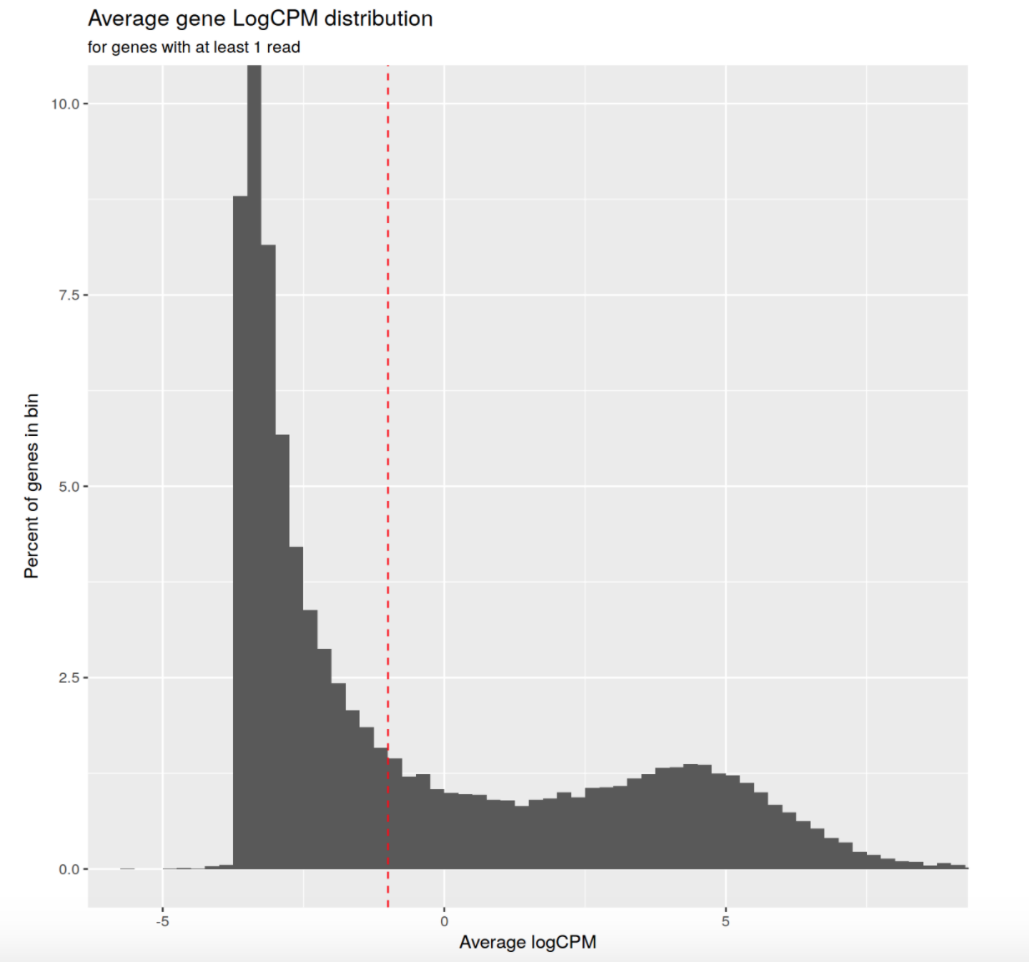
Library size - Count Per Million
Sequenced one library with 5 million(M) reads.
Total 4 M matched to the genome sequence
5000 reads matched to a given gene
Filter on count-per-million (CPM) values to avoid favoring genes that are expressed in larger libraries over those expressed in smaller libraries
A gene at least 10–15 counts in at least some libraries before it is considered to be expressed

Slide 25
Which other factors might cause variation in counts?
Gene length
Commonly used normalization method that includes gene length correction
RPKM /FPKM (Reads/Fragments Per Kilobase per Million)
TPM (Transcripts Per kilobase Million)
Not very relevant for samples comparisons
Proved to be inadequate and biased
Notes:
https://www.rna-seqblog.com/rpkm-fpkm-and-tpm-clearly-explained/

Slide 26
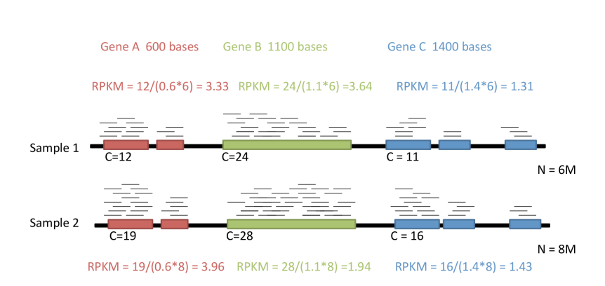
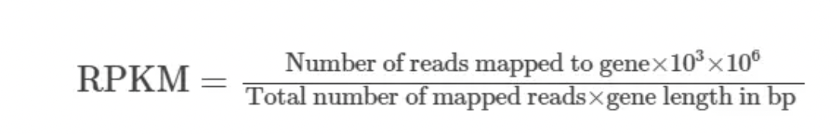
One library with 5 M reads
Total 4 M matched to the genome sequence
5000 reads matched to a given gene with a length of 2000 bp.
RPKM: depth and length bias
Biased: differentially expressed genes as the total normalized counts for each sample will be different
Notes:
https://www.rna-seqblog.com/rpkm-fpkm-and-tpm-clearly-explained/
RPKM:
Count up the total reads in a sample and divide that number by 1,000,000 – this is our “per million” scaling factor.
Divide the read counts by the “per million” scaling factor. This normalizes for sequencing depth, giving you reads per million (RPM)
Divide the RPM values by the length of the gene, in kilobases. This gives you RPKM.
FPKM is used especially for normalizing counts for paired-end RNA-seq data in which two (left and right) reads are sequenced from the same DNA fragment. Generally, the higher the FPKM of a gene, the higher the expression of that gene.

Slide 27
TPM: depth and length bias
Normalize for gene length first, and then normalize for sequencing depth
TPM average is constant and is proportional to the relative RNA molar concentration
The sum of all TPMs in each sample are the same -> to compare the proportion of reads that mapped to a gene in each sample.
RPKM and FPKM -> the sum of the normalized reads in each sample may be different, and this makes it harder to compare samples directly.
Notes:
TPM:
Divide the read counts by the length of each gene in kilobases. This gives you reads per kilobase (RPK).
Count up all the RPK values in a sample and divide this number by 1,000,000. This is your “per million” scaling factor.
Divide the RPK values by the “per million” scaling factor. This gives you TPM.

Slide 28
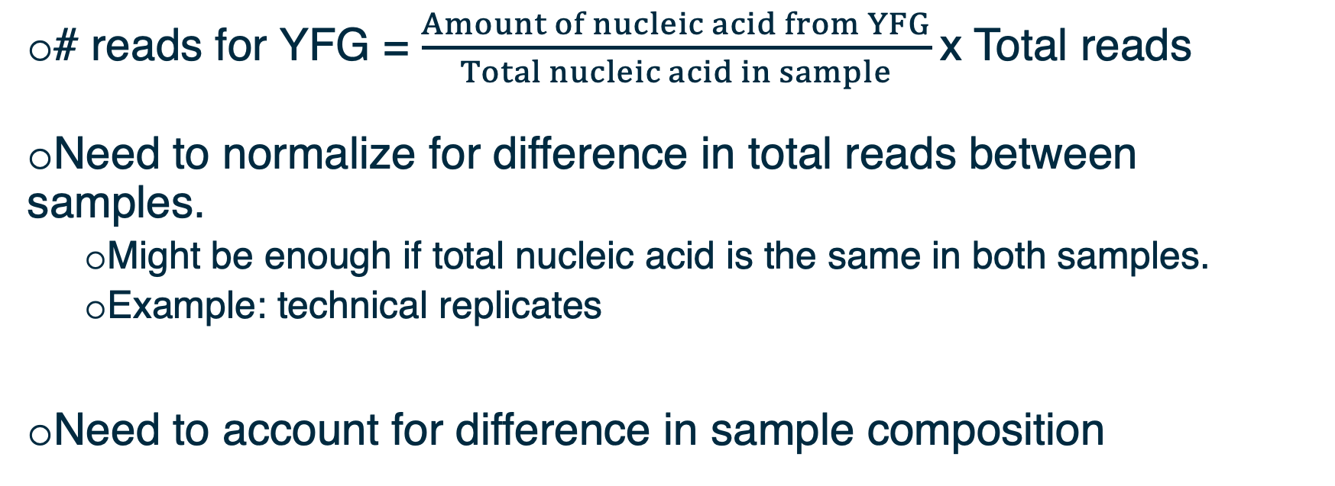
Between samples variation: observed counts depend on total reads sequenced and sample composition
Gene expression values should be compared among samples
# reads for YFG = $\frac{Amount of nucleic acid from YFG}{Total nucleic acid in sample}$x Total reads
Need to normalize for difference in total reads between samples.
Might be enough if total nucleic acid is the same in both samples.
Example: technical replicates
Need to account for difference in sample composition

Slide 29
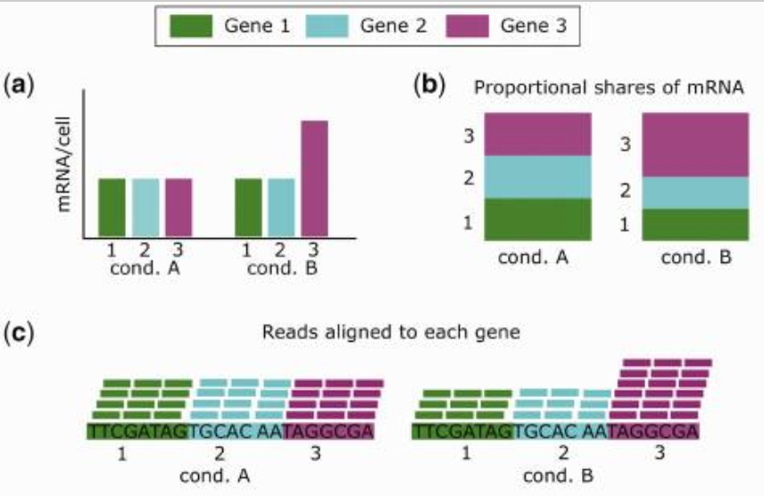
The goal is for differences in normalized read counts to represent differences in true expression
Few highly expressed genes make up a greater share of the total molecules
Smaller fraction of the reads will be left for the other genes
doi: 10.1093/bib/bbx008
Notes:
https://academic.oup.com/bib/article/19/5/776/3056951

Slide 30
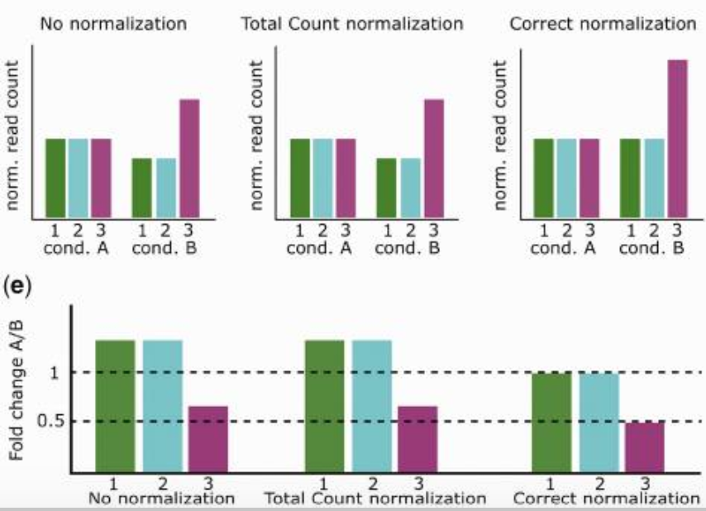
The goal is for differences in normalized read counts to represent differences in true expression
Total read count for each sample is the same
doi: 10.1093/bib/bbx008
Notes:
https://academic.oup.com/bib/article/19/5/776/3056951

Slide 31
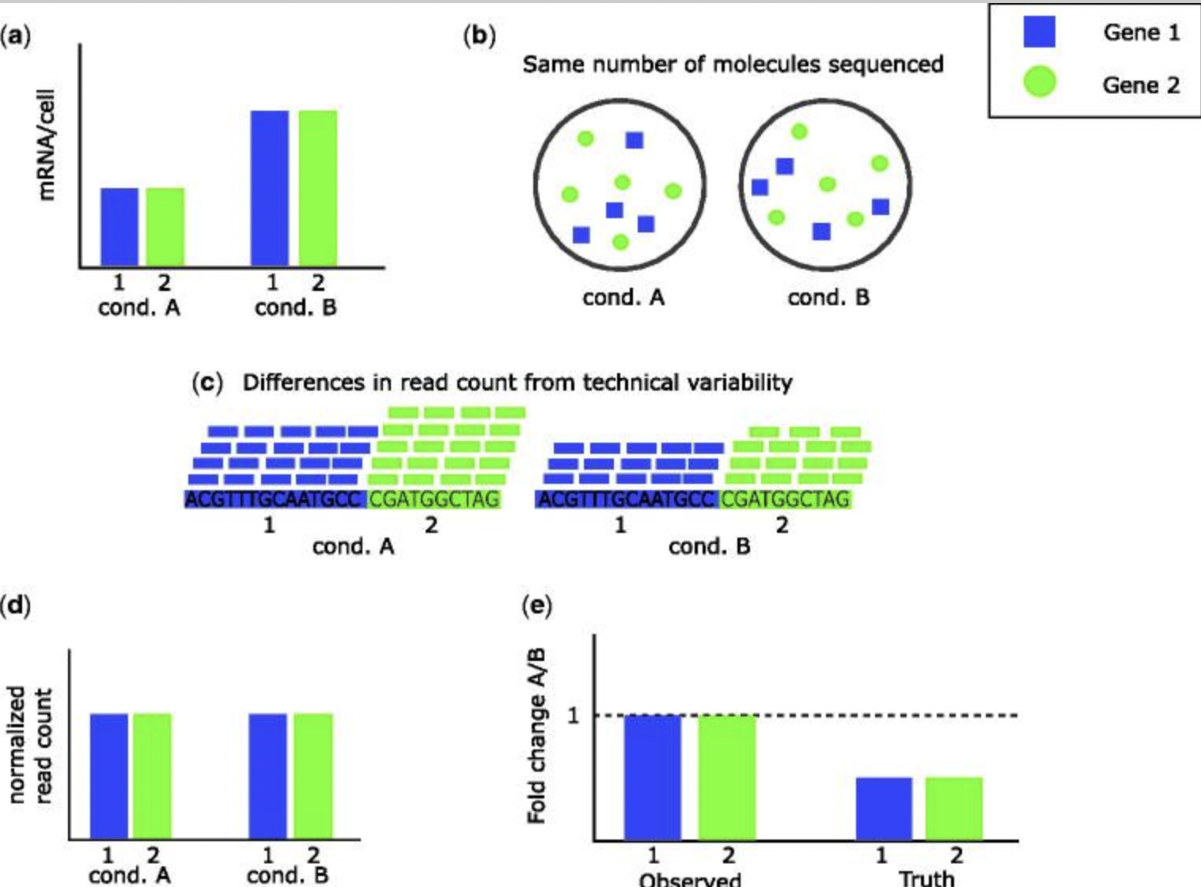
The goal is for differences in normalized read counts to represent differences in true expression
doi: 10.1093/bib/bbx008
Notes:
https://academic.oup.com/bib/article/19/5/776/3056951

Slide 32
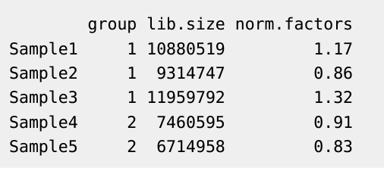
Scaling factors
Normalize for RNA composition differences by scaling factor
A few highly differentially expressed genes may have a strong influence on read counts -> minimizing effect of such genes
Assumption: A majority of transcripts is not differentially expressed
Adjust counts such that for most genes, counts are not differential.

Slide 33
Between sample normalization
Normalize for RNA composition by a set of scaling factors that minimize the log-fold changes between the samples for most genes
Reference sample: have the closest average expressions to mean of all samples
Test samples: other samples
Scaling factor: weighted mean of log ratios between the test and reference, from a gene set removing most/lowest expressed genes (avg read counts) and genes with highest/lowest log ratios (differences in expression)

Slide 34
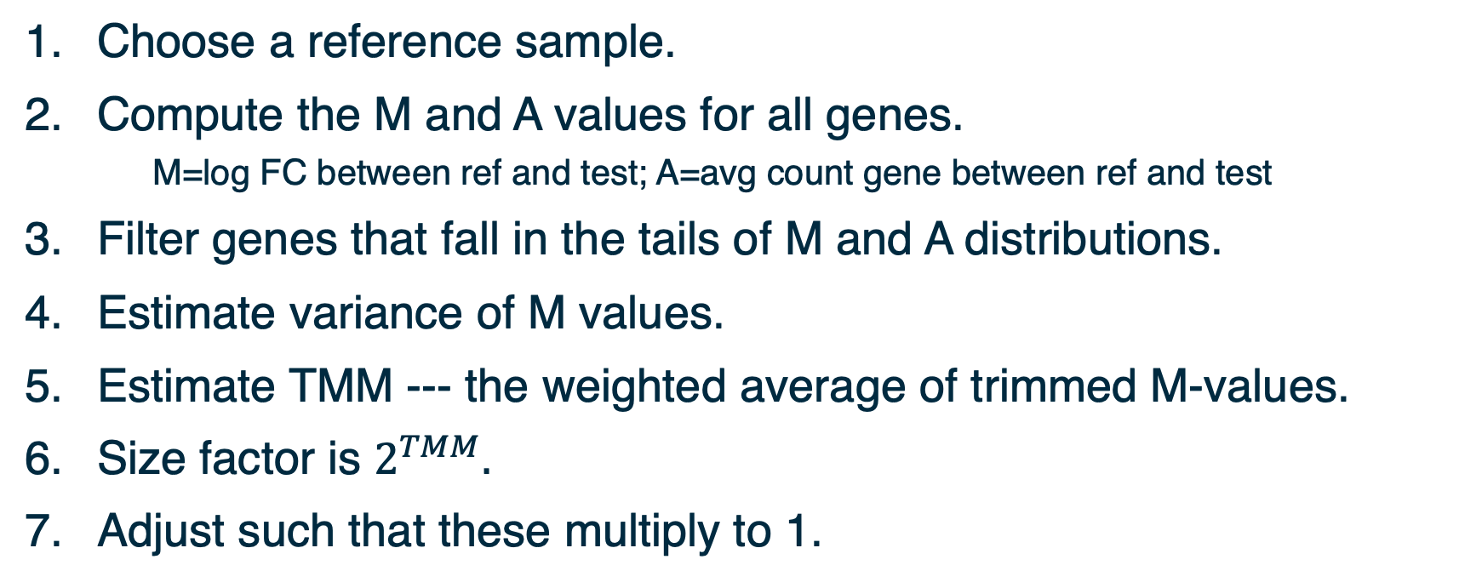
Normalization: Trimmed Mean of M-values
Choose a reference sample.
Compute the M and A values for all genes.
M=log FC between ref and test; A=avg count gene between ref and test
Filter genes that fall in the tails of M and A distributions.
Estimate variance of M values.
Estimate TMM --- the weighted average of trimmed M-values.
Size factor is $2^{TMM}.$
Adjust such that these multiply to 1.
TMM is implemented in edgeR and performs better for between-samples comparisons
Notes:
Another approach is TMM˜[15], which measures the trimmed mean of M and A values (M values are the log fold change in the number of reads aligning to a region of interest measured relative to an average or arbitrary sample, A is the average count of a gene; the trimmed mean discards regions of interest that have extreme M or A values and calculates the mean M value of the remainder); the inverse of this mean is used to weight samples.
To see how the weights are calculated:
$M=\log_{2}\left(\frac{X_{2}}{N_{2}}\right)−\log_{2}\left(\frac{X_{ref}}{N_{ref}}\right)$
$⇒Var\left(M\right)=Var_{2}+Var_{ref},$where $Var_{ref}=Var\left(\log_{2}\left(\frac{X_{ref}}{N_{ref}}\right)\right)$
and $Var_{2}=Var\left(\log_{2}\left(\frac{X_{2}}{N_{2}}\right)\right)$.
Assume $N_{2}$ and $N_{ref}$ are constant.
$$⇒Var_{2}=Var\left(\log_{2}\left(X_{2}\right)\right)$$
$$and, Var_{ref}=Var\left(\log_{2}\left(X_{ref}\right)\right)$$
Note:
a. $Var\left(X\right)=X\left(1−\frac{X}{N}\right)$ if $X$ is binomially distributed.
b. In general, if $Y=aX$, then $Var\left(Y\right)=a^{2}Var(X)$.
c. The slope of $\log_{2}{(x)}$ at some $x_{0}$ is proportional to $\frac{1}{x_{0}}$.
$$⇒Var∝{\left(\frac{1}{X}\right)}^{2}.X\left(1−\frac{X}{N}\right)$$
$=\frac{N−X}{NX}$

Slide 35
Between samples variability
TMM normalization method assumes that most of the genes are not differentially expressed
TMM normalize the total RNA output among the samples and does not consider gene length or library size for normalization
TMM good choice to remove the batch effects while comparing the samples from different tissues or genotypes or in cases where RNA population would be significantly different among the samples
If a small proportion of highly expressed genes consume a substantial proportion of the total library size for a particular sample, this will cause the remaining genes to be under-sampled for that sample.

Slide 36
Other approaches to normalization
RLE approach by Anders and Huber (2010)
Reference: geometric mean of all samples
Normalization factor: median ratio of each sample to the reference
RLE and TMM give similar results with real and simulated data
R package DESeq
Upper quartile normalization by Bullard et al (2010)
Normalization factor: 75% quantile of the counts for each sample
Not recommended in general
Total number of reads : TC (Marioni et al. 2008)
Control genes (housekeeping genes, spike-in) to estimate technical noise (RUVSeq - 2014 )
Notes:
More about normalization methods: https://bmcgenomics.biomedcentral.com/articles/10.1186/s12864-020-6502-7
Relative Log Expression - Anders, S, Huber, W (2010). Differential expression analysis for sequence count data. Genome Biology 11, R106.
Bullard JH, Purdom E, Hansen KD, Dudoit S. (2010) Evaluation of statistical methods for normalization and differential expression in mRNA-Seq experiments. BMC Bioinformatics 11, 94.
RUVSeq https://bioconductor.org/packages/devel/bioc/manuals/RUVSeq/man/RUVSeq.pdf

Slide 37
Best practice to choose a normalization
An effective normalization should result in a stabilization of read counts across samples
TC, RPKM, UQ - Adjustment of distributions, implies a similarity between RNA repertoires expressed
DESeq, TMM - More robust ratio of counts using several samples, suppose that the majority of the genes are not DE
RUVSeq - Powerful when a large set of control genes can be identified
Notes:
A comprehensive evaluation of normalization methods for Illumina high-throughput RNA sequencing data analysis : https://academic.oup.com/bib/article/14/6/671/189645?login=false

Slide 38
MDS and PCA plots
Notes:
For multidimensional scaling and PCA:
Look up Ali Ghodsi’s lectures on youtube.

Slide 39
Assessing overall similarity across samples
Which samples are similar to each other, which are different?
Does this fit to the expectation from the experiment’s design?
What are the major sources of variation in the dataset?

Slide 40
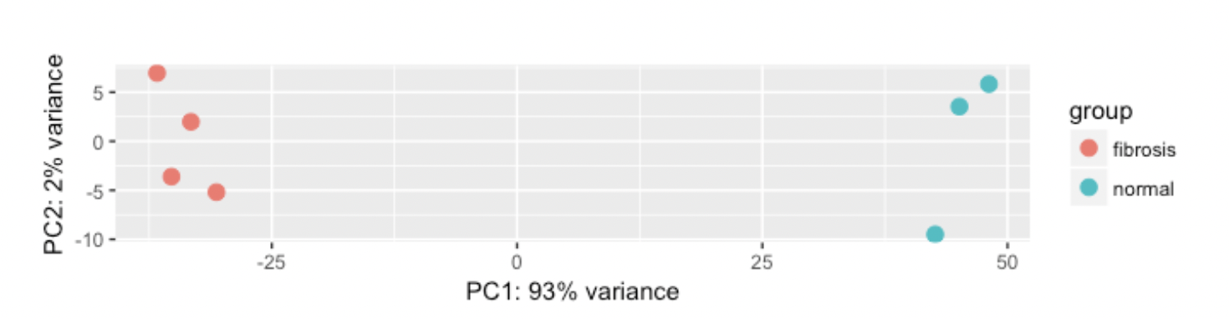
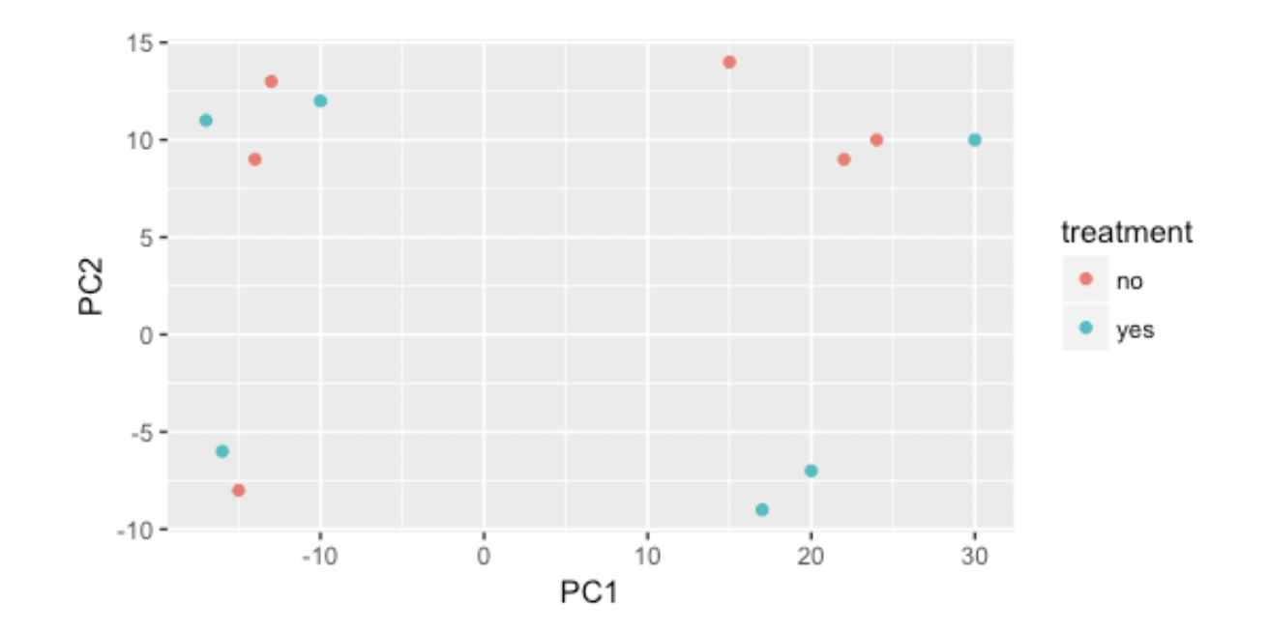
Ideal vs real experiment

Slide 41
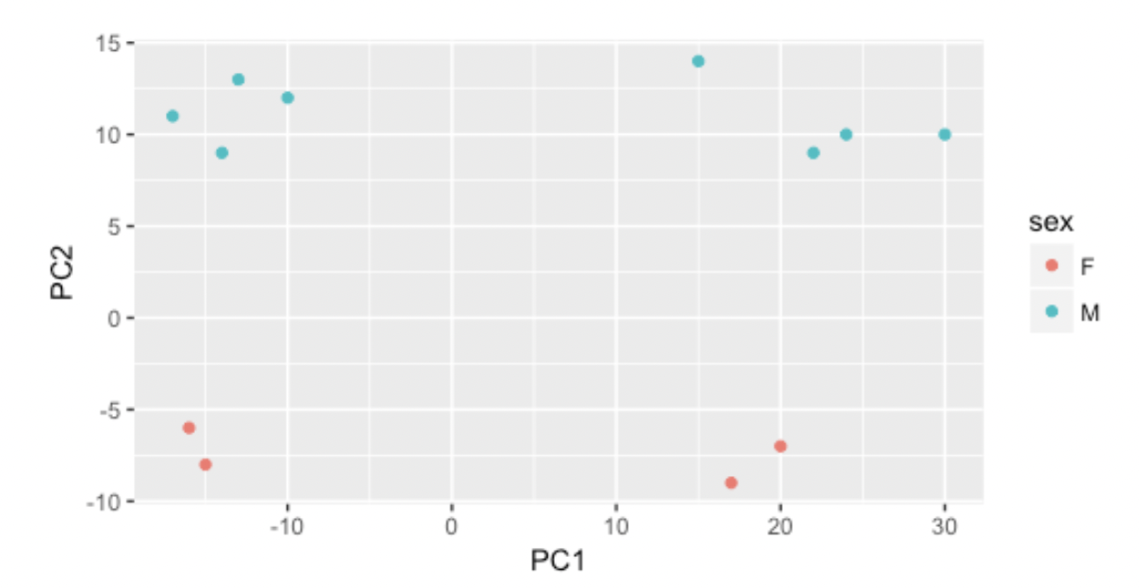
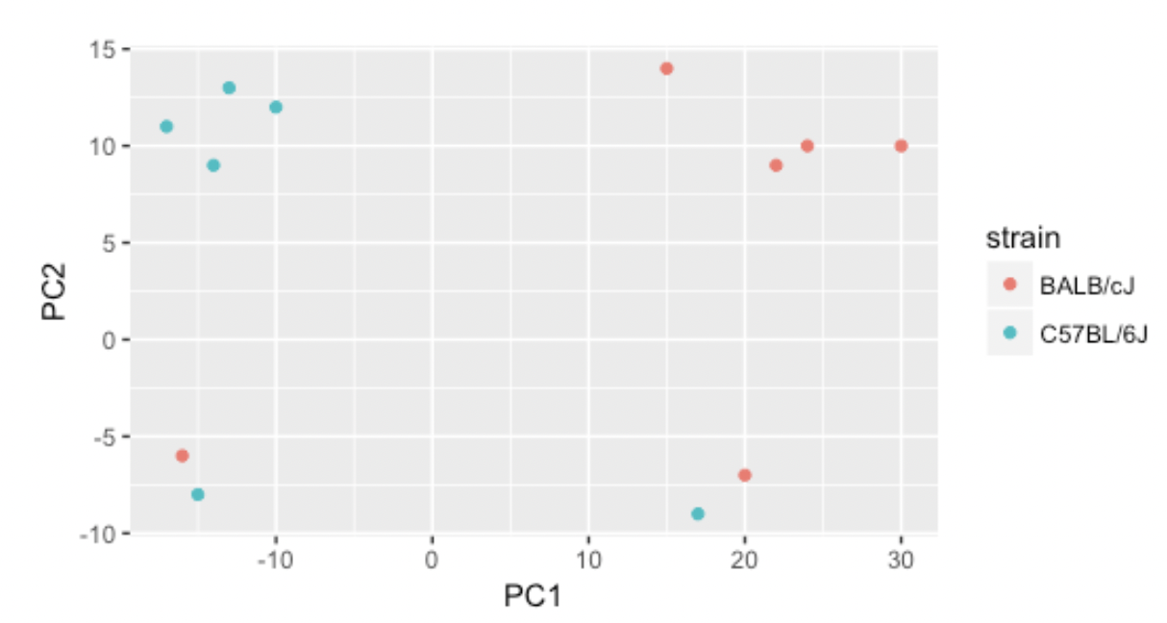
Identifying the source of variability
Variation in PC2
Variation in PC1
Notes:
.

Slide 42
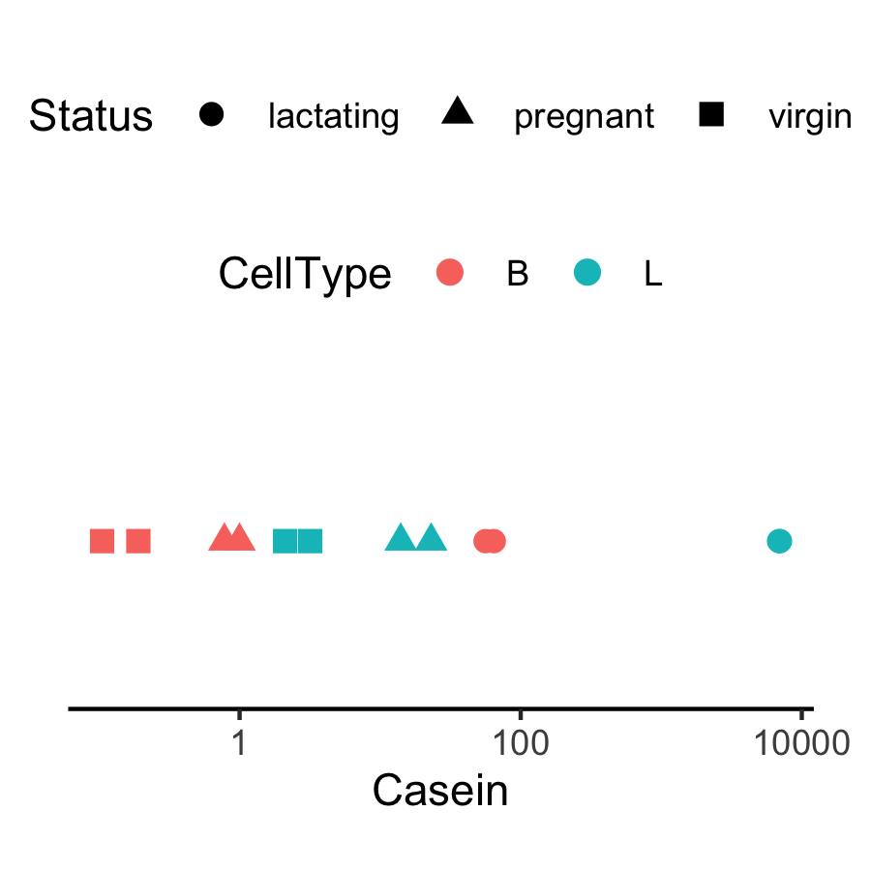
Expression level of Casein varies in a way that is strongly indicative of the effect of CellType and Status.
Why are the B.lactating samples not close to B.virgin and B.pregnant samples?
Could it be due to batch effects?
The distance between each pair of samples can be interpreted as the leading log-fold change between the samples for the genes that best distinguish that pair of samples.

Slide 43
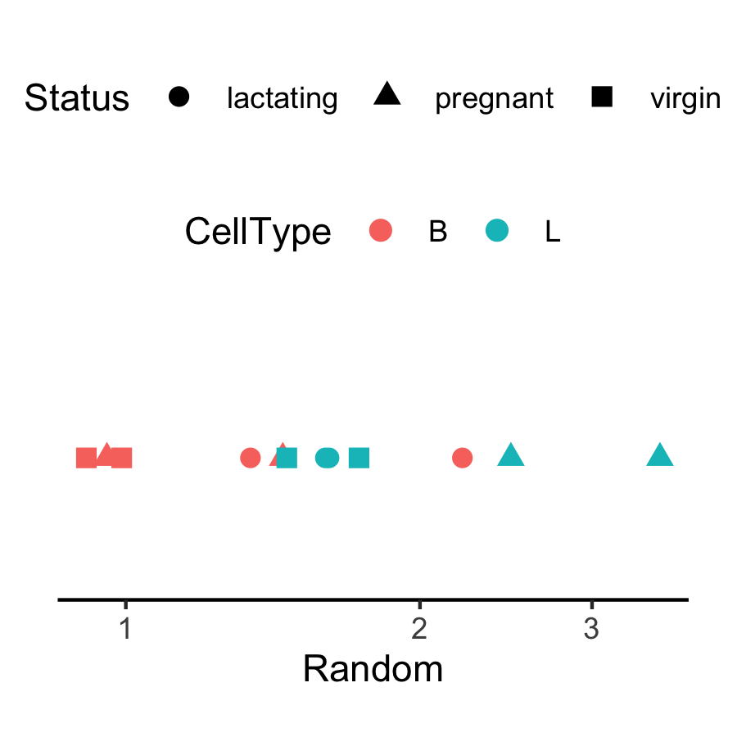
Expression appears to vary across samples but…
In general, the way expression appears to vary across samples could be dominated by noise, batch effects, real signal, etc.

Slide 44
Fitting the model

Slide 45
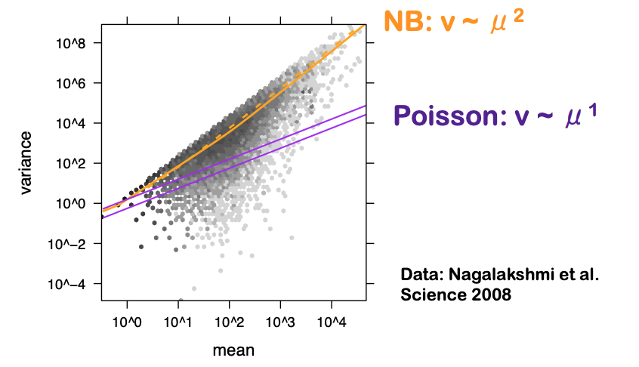
RNA-seq data and overdispersion between samples
The number of reads that are mapped into a gene was first modeled using a Poisson distribution
Assumption: assumes that mean and variance are the same
The variance grows faster than the mean in RNAseq data.
Overdispersion in RNA-seq data
-> counts from biological replicates tend to have variance exceeding the mean
-> underestimation of the biological variance increased type I error rate (probability to falsely declare a gene DE)

Slide 46
Three dispersion estimates
The negative binomial (NB) distribution alternative to model the read counts for each gene in each sample
The variance is always larger than the mean for the negative binomial ⇒ suitable for RNA-seq data
Many genes, few biological samples - difficult to estimate φ on a gene-by-gene basis
Using information across genes for stable estimates of φ.
3 ways to estimate φ: common, trended, tagwise (moderated)
Empirical Bayes moderated dispersion for each individual gene

Slide 47
Empirical Bayes estimates of dispersion parameters: Learning from the experience of others
Dispersion accounts for variability between biological replicates
Common dispersion: a global dispersion estimate averaged across the genome
Trended dispersion: dispersion of a gene is predicted from its abundance
Tagwise dispersion: measure of the degree of inter-library variation for that tag – plotBCV (biological coeff variation)
Empirical Bayes estimates need to be controlled for the possibility of outlier genes with exceptionally large or small individual dispersions (robust=TRUE)
Notes:
plotBCV() plots the tagwise biological coefficient of variation (square root of dispersions) against log2-CPM.
https://smartech.gatech.edu/bitstream/handle/1853/35125/efron_videostream.html?sequence=8&isAllowed=y
Robbins, Herbert. An Empirical Bayes Approach to Statistics. Proceedings of the Third Berkeley Symposium on Mathematical Statistics and Probability, Volume 1: Contributions to the Theory of Statistics, 157--163, University of California Press, Berkeley, Calif., 1956. https://projecteuclid.org/euclid.bsmsp/1200501653
http://seqanswers.com/forums/showthread.php?t=5591

Slide 48
glmQLFit and variance of gene counts
NB dispersions - higher for genes with very low counts and decrease smoothly with abundance and to asymptotic to a constant value for genes with larger counts.
Extended NB model to account for gene-specific variability from both biological and technical sources (quasi-likelihood)
NB dispersion trend is used to describe the overall biological variability across all genes (fit GLM)
For each gene-specific variability above and below the overall level (deviance) is picked up by the QL dispersion

Slide 49
edgeR statistical method
Classic (pairwise comparisons between two or more groups), glm and glmQL
QL for bulk RNA-seq:
+ stricter error rate control (more rigorous dispersion and uncertainty)
+ speed improvement compared to other quasi-methods
+ appropriate for multiple treatment factors and with small # of biological replicates
+ relative changes in expression levels between conditions (not absolute)
Limma package for large scale datasets
Notes:
https://www.bioconductor.org/packages/release/bioc/vignettes/edgeR/inst/doc/edgeRUsersGuide.pdf

Slide 50
Get the DE genes - glmQLFTest
Identifies differential expression based on statistical significance regardless of how small the difference might be -> 5000 DE genes between the basal pregnant and lactating groups.
Interested only in genes with large expression changes -> subset of genes more biologically meaningful.
Modify the statistical test to evaluate variability as well as the magnitude of change of expression values -> expression changes greater than a specified threshold
Not equivalent to a simple fold change cutoff.
The total number of DE genes identified at an FDR of 5% can be shown with decideTestsDGE()

Slide 51
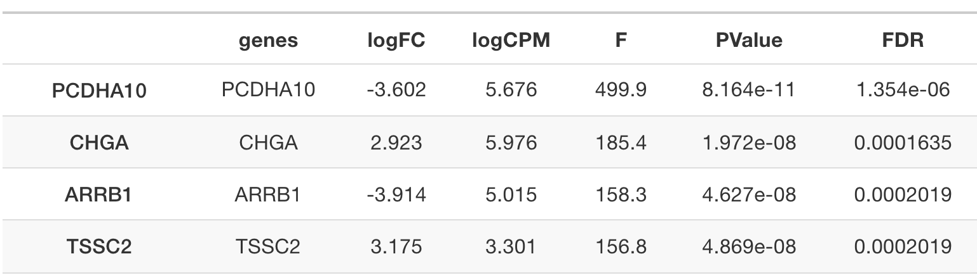
Get the DE genes - glmQLFTest
Complicated contrasts - makeContrasts()
- between lactating and pregnant mice is the same for basal cells as it is for luminal cells
- the interaction effect between mouse status and cell type

Slide 52
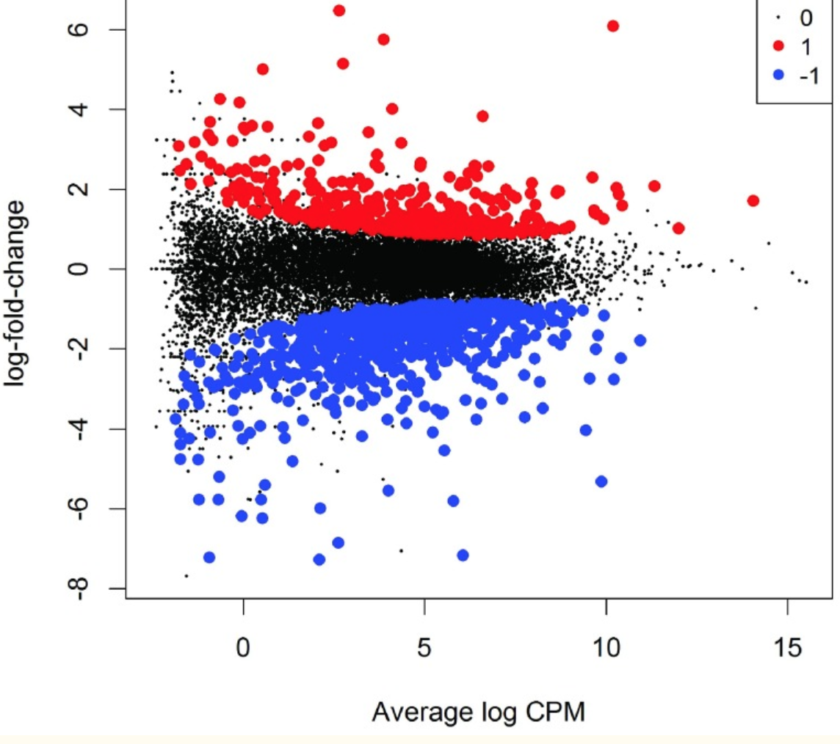
Over and under expressed genes

Slide 53
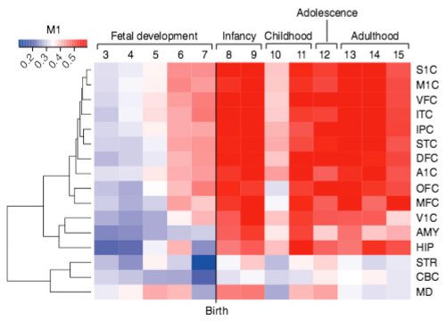
Visualization - heatmap

Slide 54
Workshop outline
Intro to a real experiment – Demo
Steps for Differentially Expressed Gene analysis
Approach for DEG: edgeR
Filtering genes
Dealing with noisy data -> Normalization
Quality check - Exploratory visualization: MDS - PCA
Fit the model for DEG - dispersion
Which comparison and how to visualize the DEG

Slide 55
Your feedback is important to us!
At the end of the hands-on session:
Please take the survey ~3 min:
https://www.surveymonkey.com/r/F75J6VZ
Real data might need additional analyses choices that need experience.
Consult with the Gladstone Bioinformatics core for such scenarios and data.

Slide 56
Hands-on session
Load and reformat the data
Exploratory visualization : MA plot
Create DGElist object and retrieve gene symbols
Filter genes with inadequate information
Exploratory visualization : MDS and PCA plots
Define and fit a model
Hypothesis testing (four example hypotheses)
Save results as a table and explore in Excel

Slide 57
Thank you!

Slide 58


